Slide 1

Workshop in Computer Communications and Information Security
Prof. Anat Bremler-Barr
TA: Ron Netzer

Slide 2
Goals
Study research topic
In most case we provide some relevant research papers or reading materials
Need to perform literature research (academic and industry)
Networking research: Academic ~ Industry challenges
Practice in preparing a project and delivering it
Working in groups each group work as independent unit
Self-learning of a subject
Use also LLM but verified it!
Code is a mean for insights or system solution
Feel free to use AI and Vibe coding but verify it!
Results should be verified ! Estimate accuracy!
Delivery : ppt, code and results (experimental results)

Slide 3
Process
Why? What? How?

Slide 4
Schedule
We have only one class meeting. Other class times are canceled. Instead
zoom meetings with mentor (2-3 meetings).
Reception time at Zoom:
Anat: Thursday 17:00 (email to schedule)
Project selection: 20.4.26
Project
Mid-semester presentation - project plan 3.6.26
At least one zoom meeting with the mentor before this submission
Presentation and a short design document and literature research
Final submission 2.9.26
Presentation and code (github)

Slide 5
Projects
Group: 2 students
Use Github
Each student is graded independently
Project per one group (FCFS)

Slide 6
Prof. Bremler-Barr: Current Topics & Techniques
Internet of Things (IoT)
DNS Security
Encrypted Traffic Classification
CVE mining
Cloud
Denial of Service Attacks
NFV\SDN
Cyber security
Techniques:
Performance Analysis
Distributed Algorithms
System
AI\ML and NLP
Network Algorithmics
Streaming algorithms
Notes:
about middleboxes, and we will design in this talk middlebox of IoT security
DDoS – since my riverhead, the company I founded 20 years ago, that mitigate DDoS attack, DDoS consume resources of the victim, sever, link, router, so it cannot provide service. In my research I useally show new DDoS attacks, and also new mitigation technique.
IoT is target of DDoS attack, and also botnets use IoT to launch DDoS attack,
DNS – one of the main target to DDoS attack, is the domain name. DNS responsible to resolve the domain name like tau.ac.il to exact IP. Well, with the evolving of the Internet, the demand from the DNS protocol has changed also, and it is very active research domain nowadays. My research focus on building more resilience DNS protocol especially from the DDoS aspect, note that many of the most harmful DDoS attack were on DNS. Since with no DNS reolution there is no internet. Today DNS will play a major rule in understanding the activity of IoT from the network prespective.
Cloud – the way web application was designed was chanced dramatically in the last ten years. Most web application runs on public or private cloud. Mostly I work again on DDoS attack on the web application that reside in the cloud. It happenes that two weeks ago I run in to this article, that talk about YoYo attack, attack which I named and presented more than 5 years ago. We named it YoYo since it is on the autoscaling mechanism in the cloud. It seems that it become a common DDoS attack. Going back to IoT, most IoT have a component on the cloud.
Network Algorithmics – my main research from the PhD, how you can design algorithm that work with ten of millions packet per second, with limited resources. But In this talk I would not talk on this aspect, it will be clear networking. But I show where is algoritmics challenges.
IoT...

Slide 7
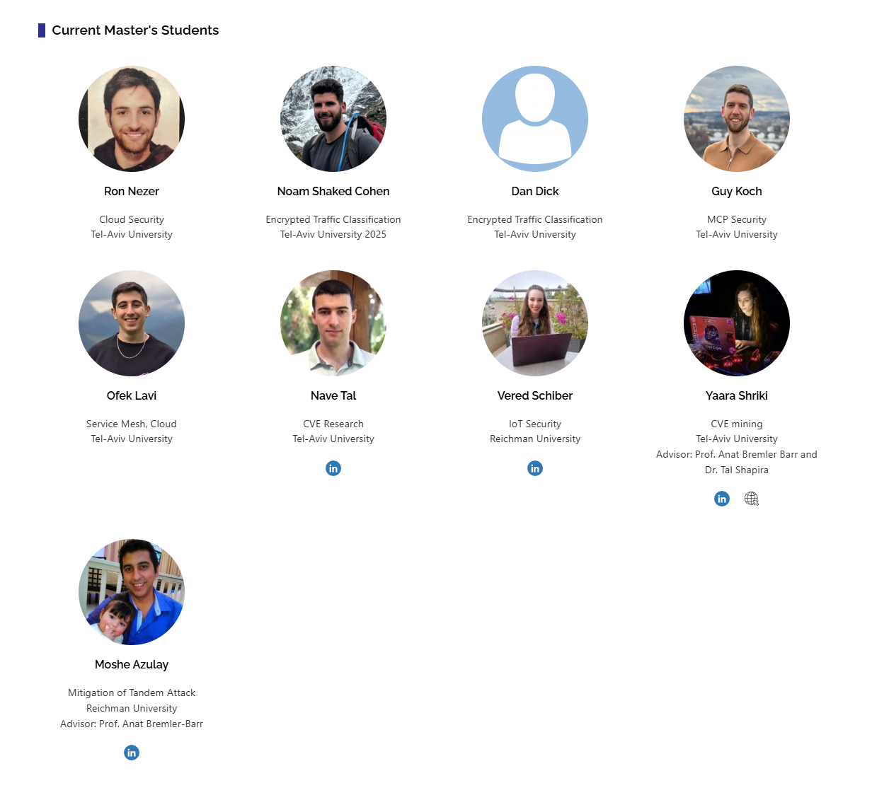
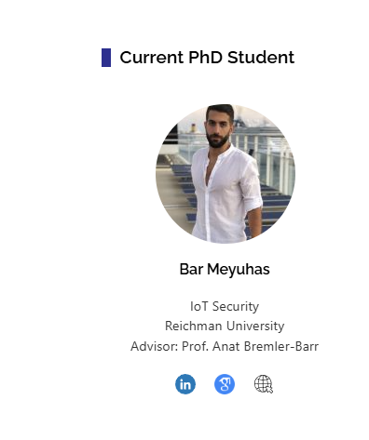



Slide 8
Projects
Cloud
ML
MCP authorization
CVE research
DNS security
Energy security
Be part of real research.
If we use your research output at a paper – you will receive acknowledgment at the minimum (according to contribution)

Slide 9


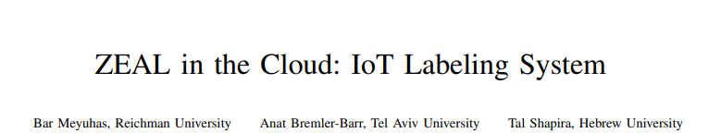
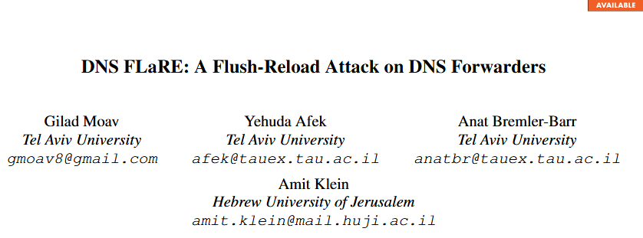
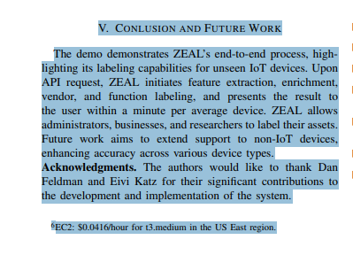
Implementation (ACK) vs Research,Innovation (Author)
No one can grantee of the research will be successful (or mature to a paper).

Slide 10
Cloud
Mentor: Jhonatan Tavori

Slide 11
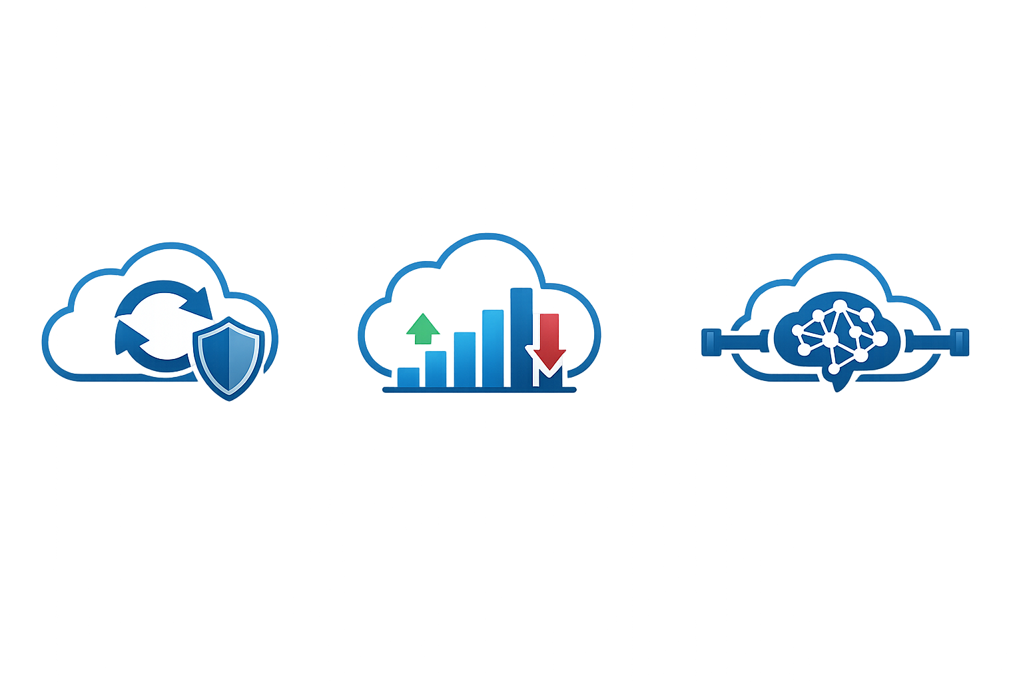
Project 1: Retries for Cloud Microservices.
Description: Modern cloud applications are built from many microservices. Their appeal to developers is that the microservices operate independently of each other. However, coordinating their operation then turns tricky and expensive to the application owner. Retry mechanisms (like you knocking on a Doctor’s door when you get impatient) suppose to help, but when something goes wrong, retries can easily worsen the problem.
In this project students will implement and evaluate, in a realistic cloud-native environment, two retry-control mechanisms (RetryGuard and DiffTry - developed in the Deepness Lab), aiming at resolving these problems, and cutting cloud costs.
Goal: This project is a good fit for students who want hands-on experimentation with cloud resiliency patterns.

Slide 12
Project 1 (cont.):
Technical description: Evaluate the impact of RetryGuard and DiffTry in a Kubernetes-based microservice setup which uses TopFull or DAGOR (ACM SIGCOMM papers) overload control mechanisms.
The implementation of TopFull/DAGOR is provided in open-source repositories.
RetryGuard and DiffTry were designed in the Deepness lab and will be integrated into the setup.
Resources:
TopFull –
https://dl.acm.org/doi/abs/10.1145/3651890.3672253
https://github.com/kaist-ina/TopFull/tree/main
DAGOR –
https://dl.acm.org/doi/10.1145/3267809.3267823
https://github.com/wwz16/dagor

Slide 13
Project 1 (cont.):
Skills needed:
Programming and scripting.
Some familiarity with Linux
Interest in cloud computing, systems, or performance analysis.
Skills gained:
Working with Kubernetes and microservice-based systems
Experience in evaluating cloud performance and resource efficiency.
Understanding retries, failures, and performance in distributed service.

Slide 14
Project 2: Cloud Systems Autoscaling.
Motivation: Cloud systems constantly scale up and down to handle changes in demand, but how often does this really happen, and what does it look like in practice? In this project, students will study scaling events using telemetry data from Alibaba and Uber.
Goal: Microservice autoscaling is one of the core ideas behind the cloud, promising its clients a “panacea” where the resources will flexibly adapt to the varying demands of their users; however – too variable traffic may lead to frequent autoscaling events and scaling synchronization problems and may pose significant costs on the clients.
This project aims at evaluating the scope of these problems by understanding the real behavior of large systems using production-inspired data.

Slide 15
Project 2 (cont.):
Technical description: Use cloud telemetry from Alibaba and Uber to measure when and how often scaling events occur in two representative cloud applications. Evaluate how these affect costs inflicted on an elementary cloud-based system.
Resources:
Alibaba:
https://dataverse.harvard.edu/dataset.xhtml?persistentId=doi:10.7910/DVN/T53HGF
https://github.com/alibaba/clusterdata/tree/master/cluster-trace-microservices-v2022
“The released traces contain the detailed runtime metrics of nearly twenty thousand microservices”
Uber:
https://zenodo.org/records/13947828
“This dataset provides comprehensive microservice traces (around 1.4 million) collected from Uber microservice architecture, as described in our paper The Tale of Errors in Microservices, presented at SIGMETRICS 2025.”

Slide 16
Project 2 (cont.):
Skills needed:
Programming and scripting.
Comfort with data analysis.
Interest in cloud computing, systems, or performance analysis.
Skills gained:
Working with large telemetry datasets.
Evaluating cloud performance and resource efficiency.
Building intuition for how modern cloud applications behave.

